Slide 1
Managing Research Data
DAVIS workshop – survival skills series

Slide 2
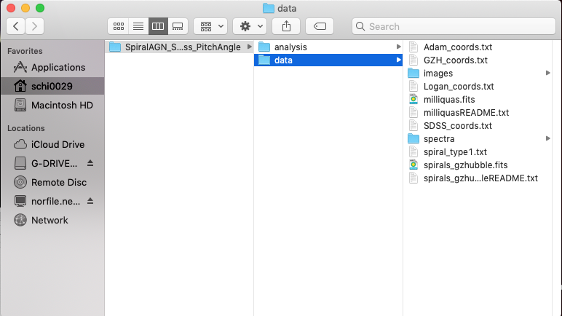
Not an actual slide; will show directory window

Slide 3
File Naming
Use – or _ or capitalization instead of spaces
this file.docx
ThisFile.docx
this_file.docx
Don’t use special characters like !@#$%^&
Be descriptive!
Is a data appropriate? YYYYMMDDleafcolor.dat
Are there multiple observers? YYYYMMDD_counts_ABS.csv
File extensions are important (.txt, .csv, .exe)
Be consistent – are there guidelines already in place? e.g.

Slide 4
File Organizaion
new_research_project
data
raw_data
reduced_data
analysis
question1
question2
literature
write_up

Slide 5
README files
Create README for each file or data set
Write as plain text file
Information to include:
Introductory – describe data (brief), name/institution/contact info Pi/Co-I, dates/locations of data collection, …
Methods – experiment design, links to documentation, instrument info, …
Data – define columns/column headings, units, symbol/value for missing data, …
Sharing/access – licenses, publications w/data, links to publically accessible data, recommended citation, …
https://libraries.ou.edu/content/how-make-readmetxt-file

Slide 6
Spreadsheet OR Database?
Spreadsheet
Database
Tabulate data
Edited directly
Quickly analyze, make charts (e.g. in Excel)
Relational data
Edited by specific software (multi-user friendly)
Can handle large data sets
Complex searching

Slide 7
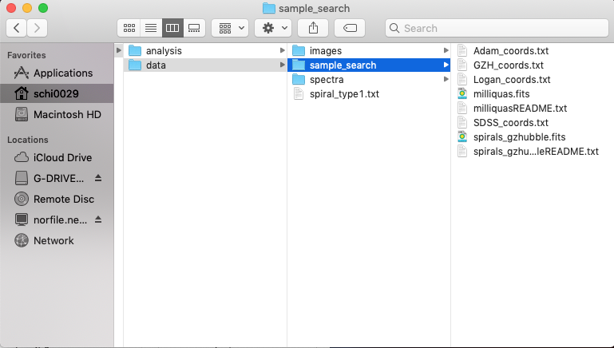
Not an actual slide; will show directory window

Slide 8
Find out more
DAVIS office hours
DAVIS workshops (DMP, DMP tools, OSF, etc.)
https://guides.ou.edu/datamanagement
Mark Laufersweiler, Research Data Specialist

Slide 9
Slide Title
Speaker Name
Title
Contact Information

